Slide 1
SIGGRAPH Paper Sharing
Presenter: Jiahui Peng
Aug 27, 2025

Slide 2
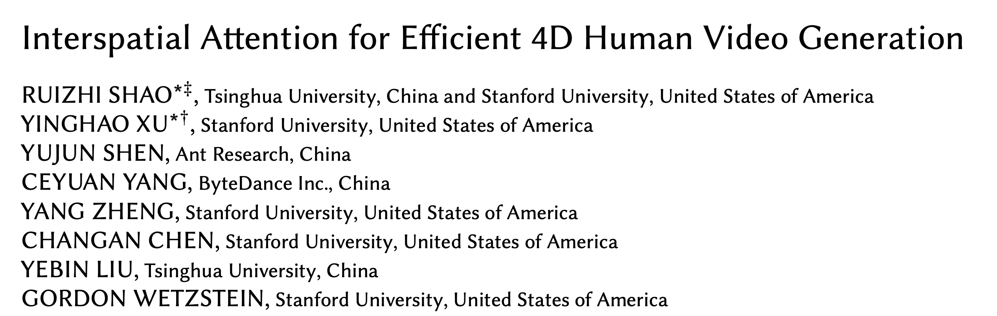

Slide 3
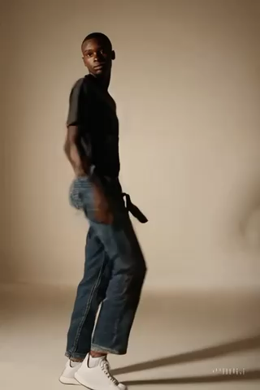
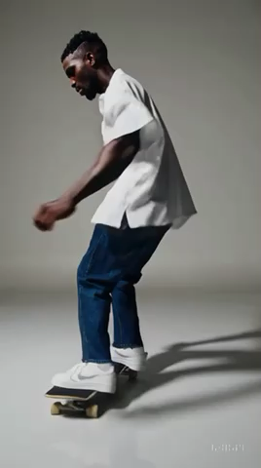
Motivation
❌ Visual artifacts in motion
❌ Limited controllability
Videos generated by Sora

Slide 4
Related Works and Challenges
Adding 2D pose control sequences to video generative models.
Hu et al., Animate Anyone: Consistent and Controllable Image-to-Video Synthesis for Character Animation, 2023

Slide 5
Related Works and Challenges
Adding 2D pose control sequences to video generative models.
Hu et al., Animate Anyone: Consistent and Controllable Image-to-Video Synthesis for Character Animation, 2023
Challenges: 2D pose as condition tasks 3D information
❌ Camera control
❌ Multi-person videos

Slide 6
Related Works and Challenges
Adding 2D pose control sequences to video generative models.
Hu et al., Animate Anyone: Consistent and Controllable Image-to-Video Synthesis for Character Animation, 2023
Challenges: 2D pose as condition tasks 3D information
❌ Multi-view consistency
❌ Camera control
❌ Multi-person videos
Solution: using 3D SMPL as condition

Slide 7
Goal
Develop a general-purpose models that support various video generation tasks, including single-person video generation, video generation with controlled camera movements, multi-person video generation and background/foreground composition.

Slide 8
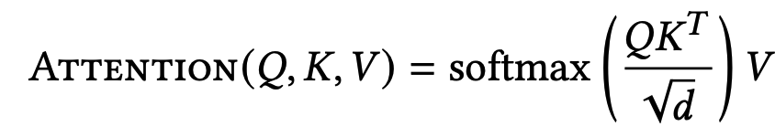
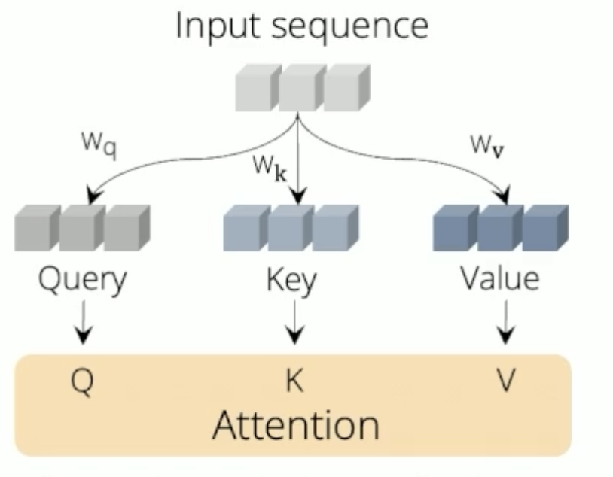
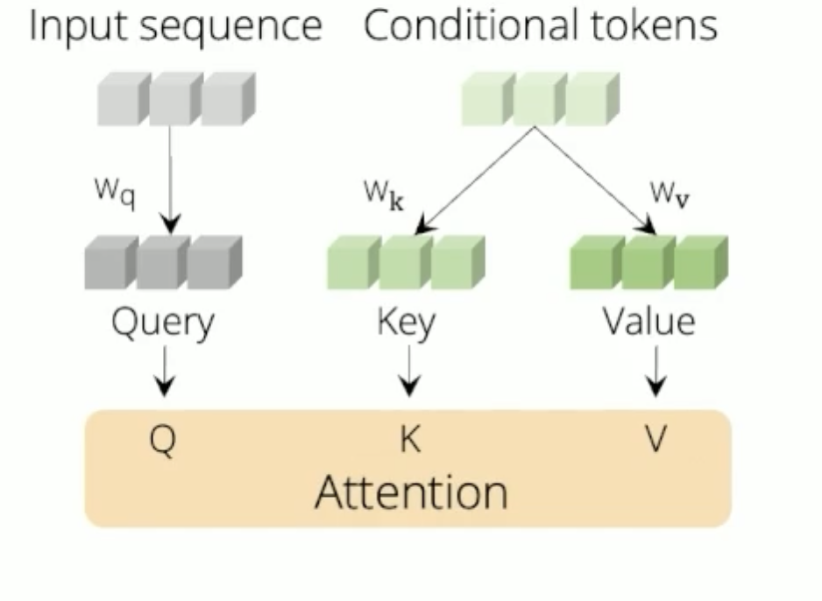
How to Enable 4D-aware Human Video Generation?
Attention mechanism

Slide 9
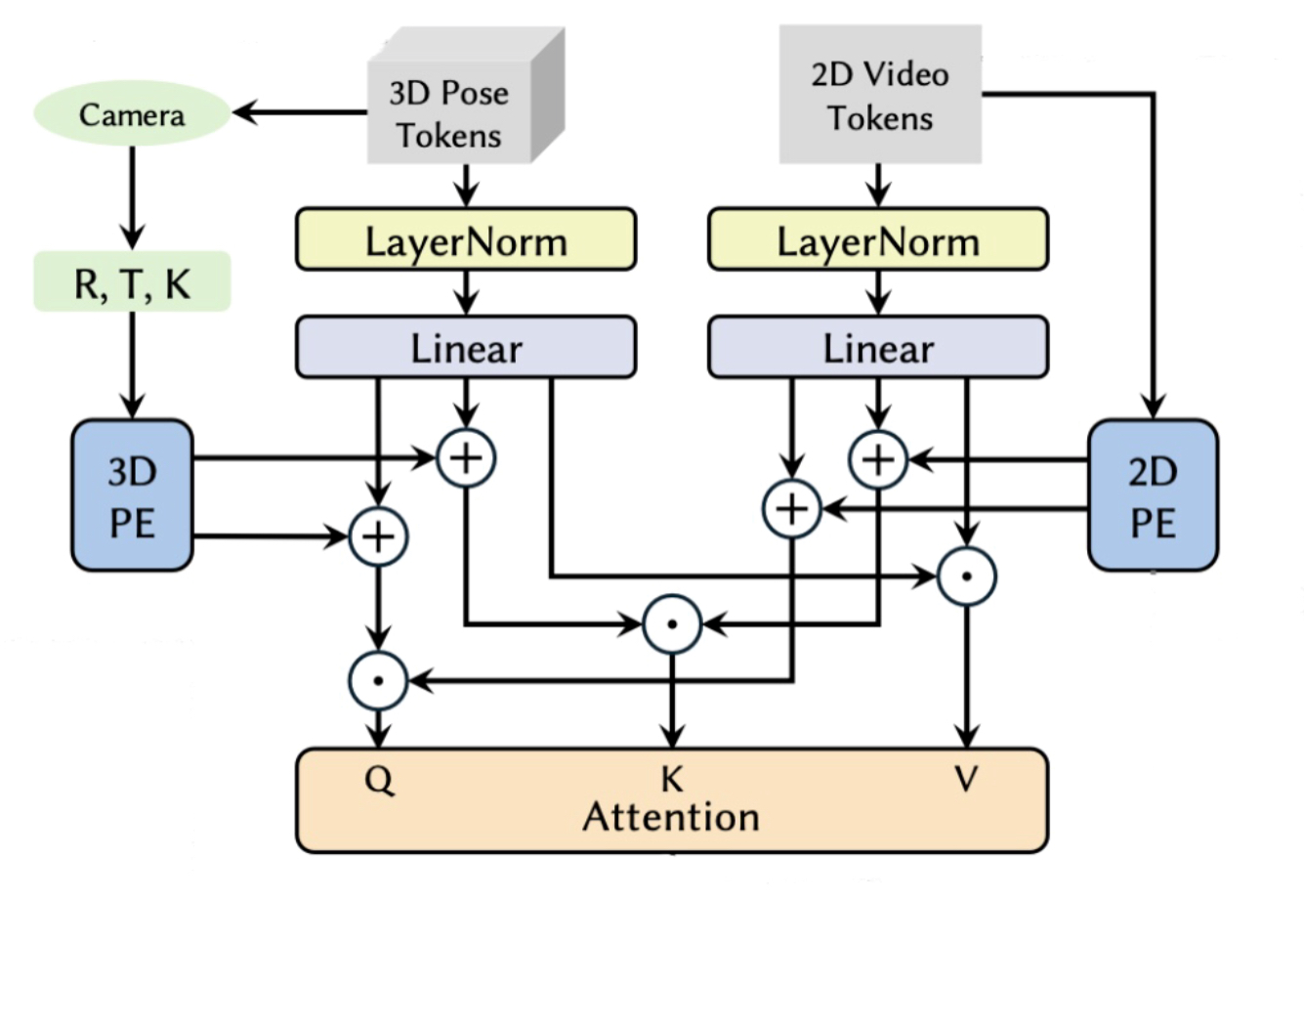
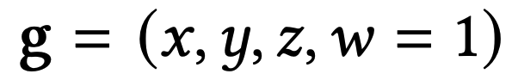
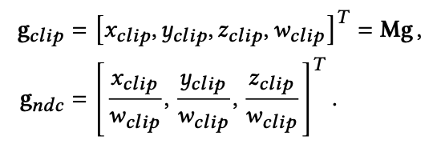
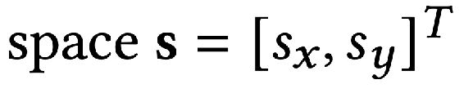
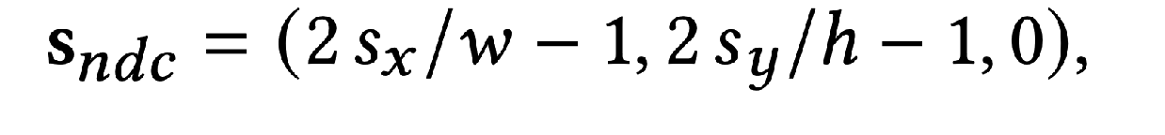
Interspatial Attention for 3D SMPL Condition
Interstitial positional encoding
For 3D SMPL tokens with coordinates
For 2D video tokens with pixel coordinates

Slide 10
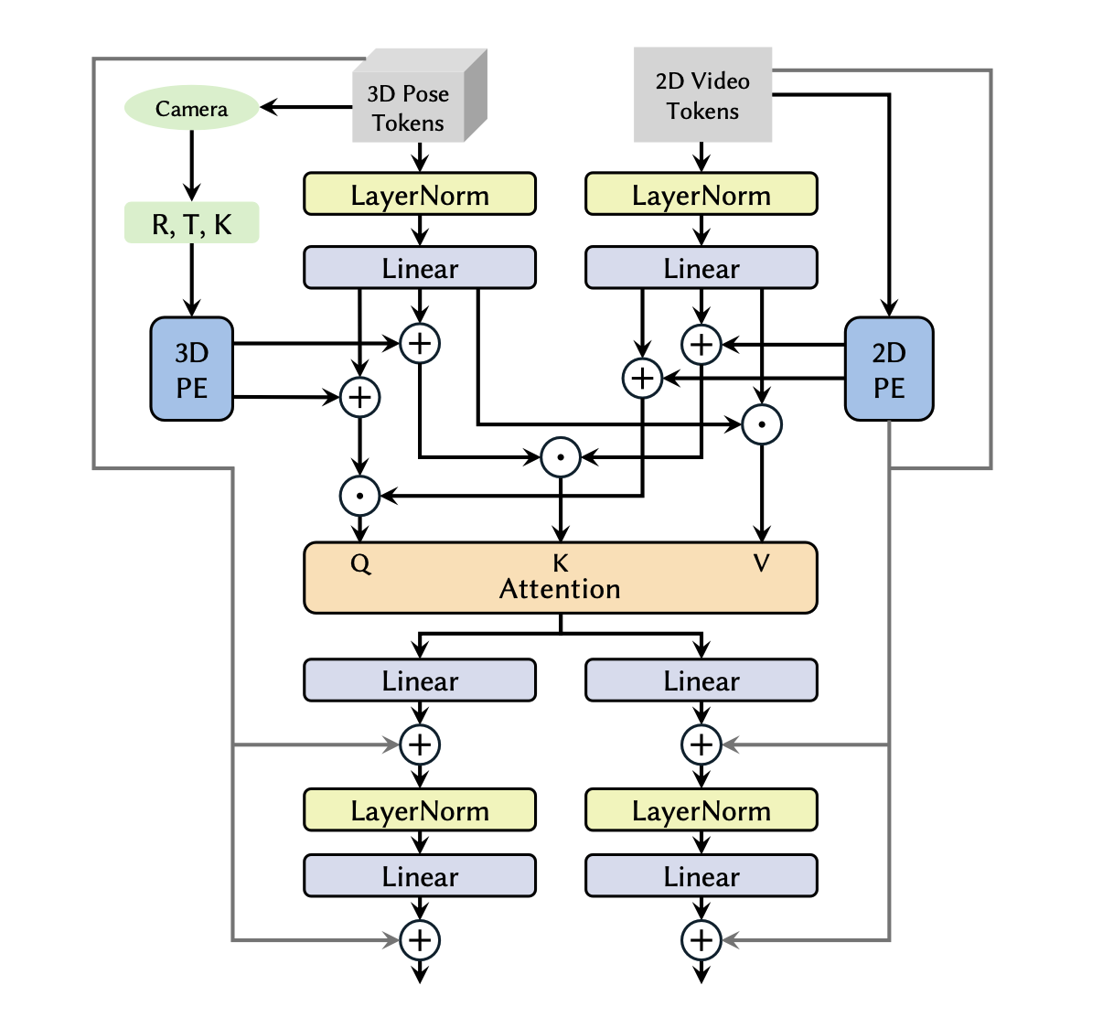
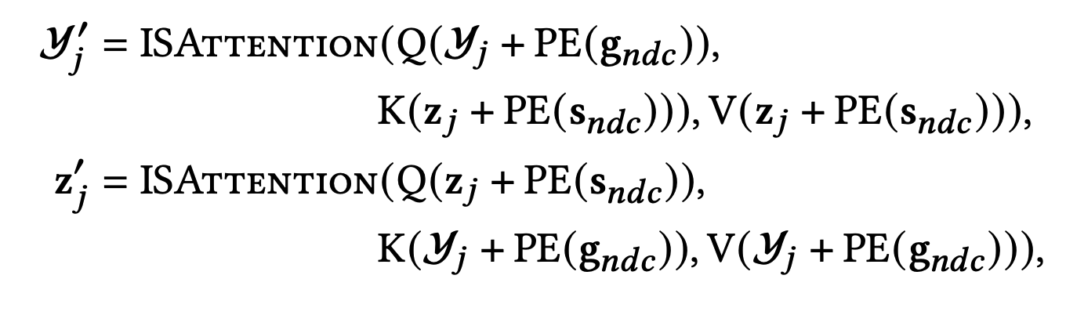
Interspatial Attention for 3D SMPL Condition
Interstitial positional encoding
For 3D SMPL tokens with coordinates
For 2D video tokens with pixel coordinates
Symmetric attention block

Slide 11
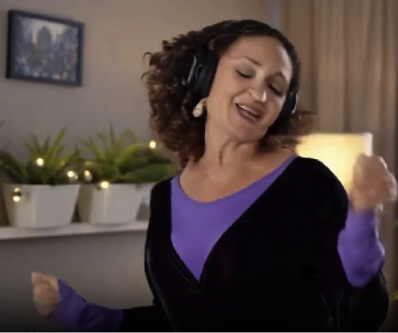
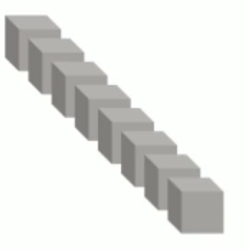
Human Video Generation Pipline
Input Conditions
Diffusion Transformer
Video VAE
Input Video
Compact Latent
Generated Latent
Stage 1: Latent representation learning
Stage 2: Latent Generation

Slide 12
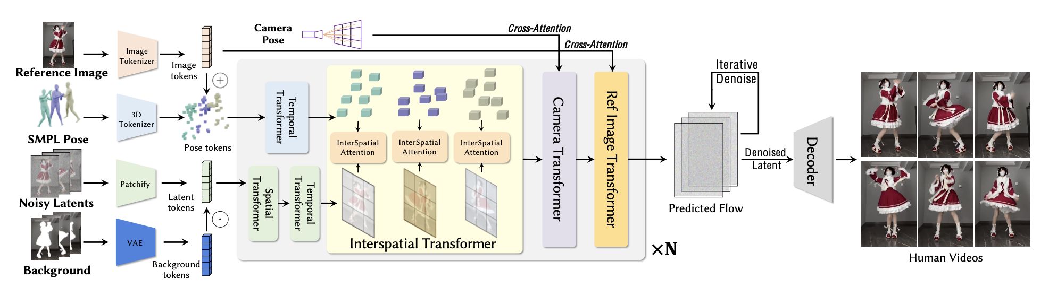
-

Slide 13
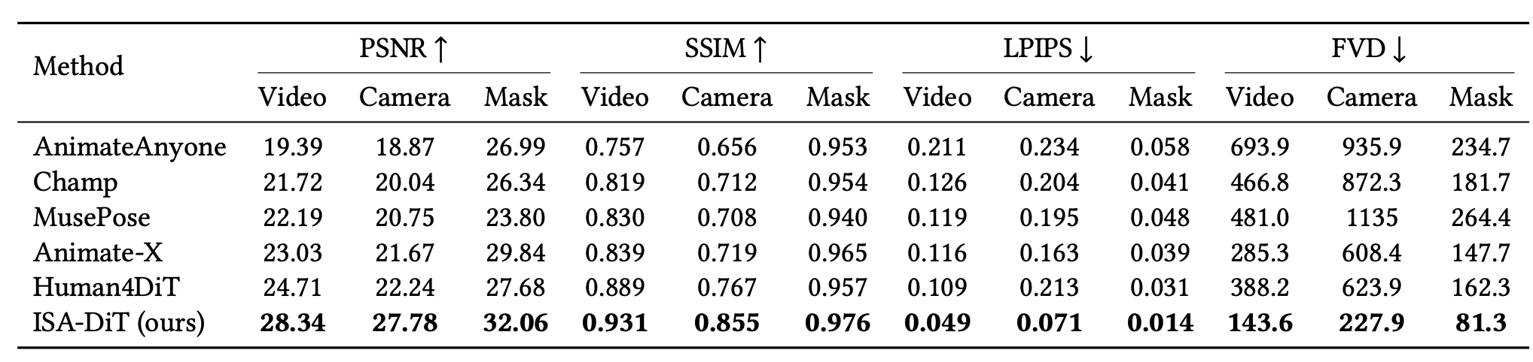
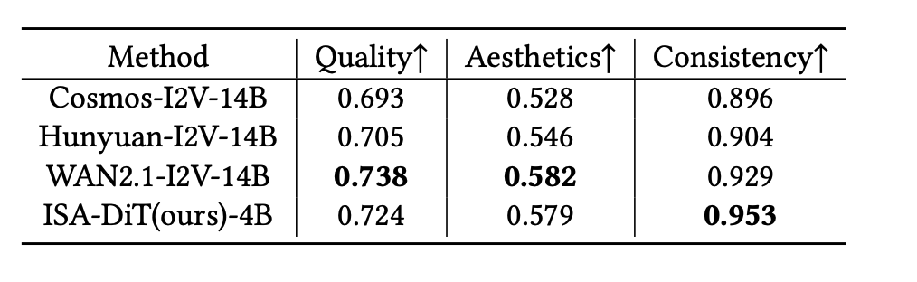
Quantitive Result

Slide 14
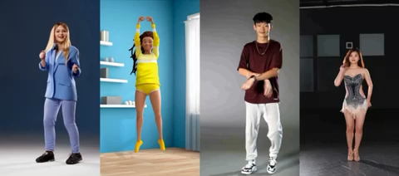
Qualitative Result
Single Human Generation

Slide 15
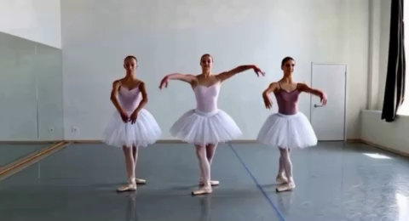
Qualitative Result
Multi-Human Generation

Slide 16
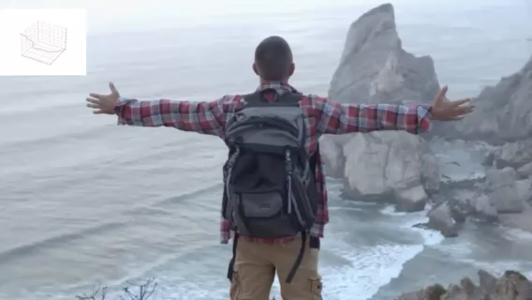
Qualitative Result
Camera Control Generation

Slide 17
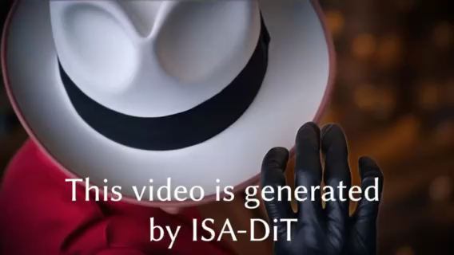

Slide 18
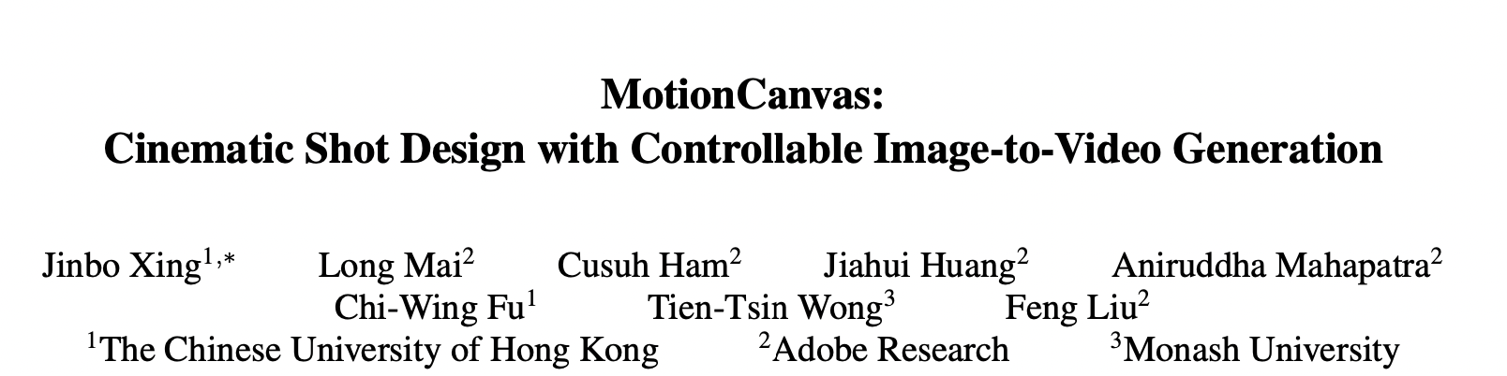

Slide 19
Motivation
Currently, most Text-Image-to-Video generation adopts text-motion guidance.
However, text prompt exhibits limitations in precisely regulating camera motion, object motion and object local motion.
Related works that adopt bounding box control, drag-based control or camera control cannot fully address this challenge.

Slide 20
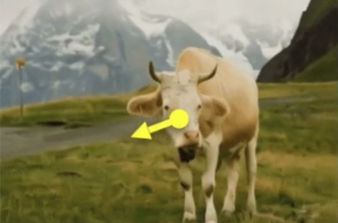
Motivation
Currently, most Text-Image-to-Video generation adopts text-motion guidance.
However, text prompt exhibits limitations in precisely regulating camera motion, object global motion and object local motion.
Related works that adopt bounding box control, drag-based control or camera control cannot fully address this challenge.
Dragging the cow’s head?
Dragging the cow’s entire body?
Dragging the camera view?

Slide 21
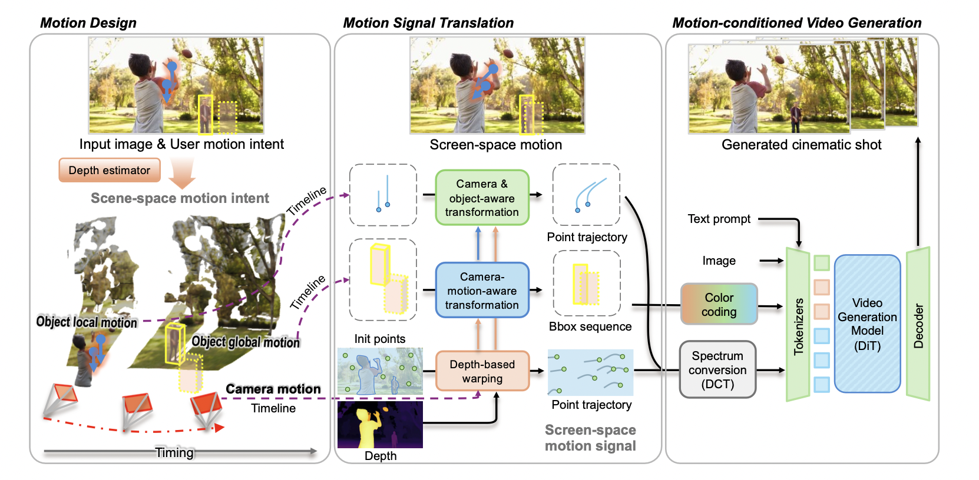
Overview of Motion Canvas

Slide 22
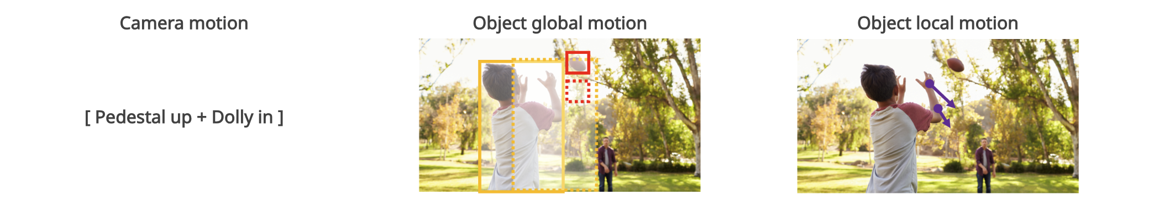
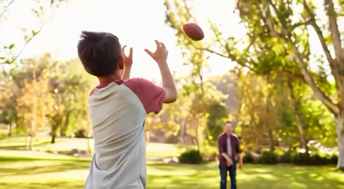

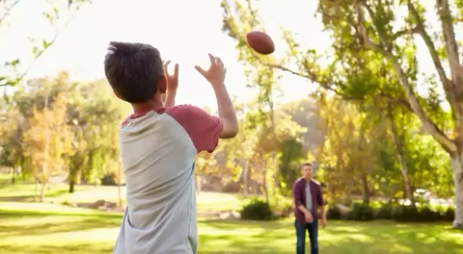
Qualitative Result

Slide 23
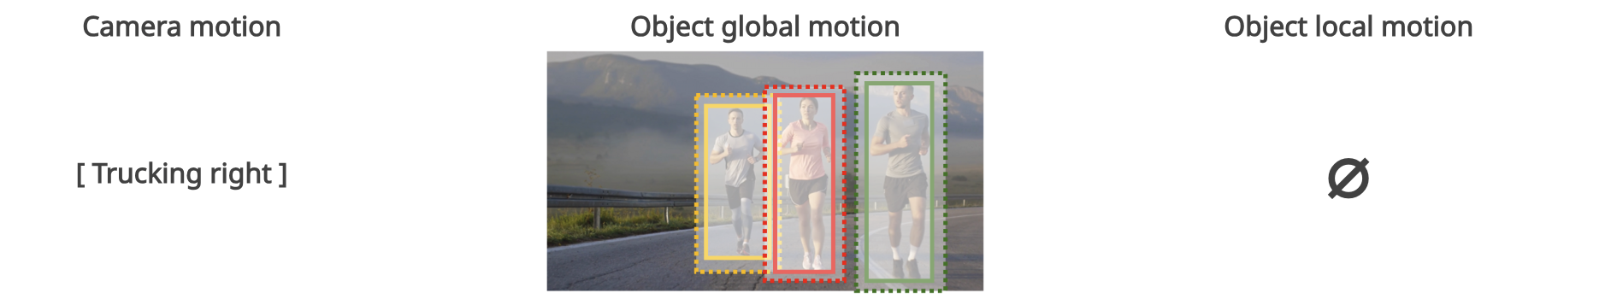
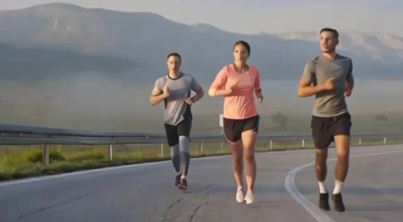
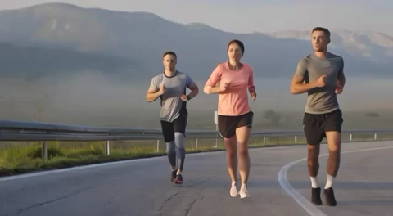
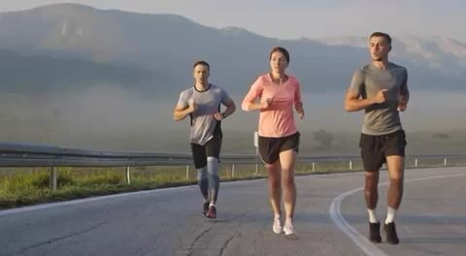
Qualitative Result

Slide 24
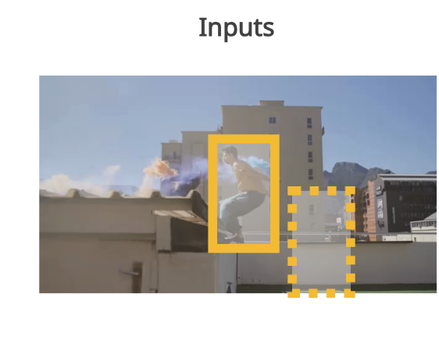

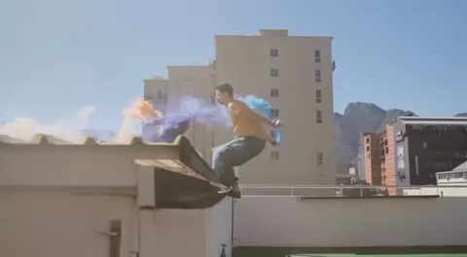


Qualitative Result

